Slide 1
Startup 101 & The lean startup
Eric Hartman
Associate Director, New Ventures

Slide 2
What is a startup?
“A startup is a human institution designed to create a new product or service under conditions of extreme uncertainty.”
Eric Ries
The Lean Startup

Slide 3
Startup Characteristics
Idea
Rich & Famous
Unknown
Innovative
Technology
Pivot
Small Business
High Risk
Nymble
New
Failure
Flexible
Entrepreneur
Investors
Fast Paced
Lean
Notes:
Innovative, Idea, Technology, Rich & Famous, Unknown, Small Business, New, Nymble, High Risk, Pivot, Failure, Flexible, Entrepreneur, Investors, Lean, Fast Paced

Slide 4
What is the purpose of a startup?

Slide 5
Startup Business Development Process
Value
Activity
Idea
IP Protection
Prototype
Business Plan
Beta Customers
Sales/Marketing
Paying Customers
Growth Plan
Stage
Creation
Pre-Revenue
Breakeven
Growth
Risk
High
Low

Slide 6
Value Creation is directly proportional to Risk Reduction

Slide 7
Startup Risk Questions
Who is our customer?
Do we understand our value proposition?
Do we understand the customer’s problem?
Is there a need in the marketplace?
How much will customers pay?
Will customers like our product?
What features does the product need?
How do they want to buy?
Will customers tell their friends?
How will we make money?
Will anyone use the product?
Will customers buy?
Is our product better than the competition?
Are customers willing to change?
How will we sell our product?
How will we make our product?

Slide 8
Lean startup principles
Identify Leap of Faith Assumptions (‘risk’)
Run experiments to test assumptions
Collect data to answer questions
Design and development work [only] to support experiments
Adjust business plan based on experimental results (‘pivot’)
Track progress (‘innovation accounting’)

Slide 9
ROI Ratio
Assess Degree of Risk Reduction (ΔRisk)
Budget (Cost)
Calculate Return on Investment – ROI Ratio
Prioritize by Ratio
If High Ratio (High ROI), Execute ASAP
If Low Ratio (Low ROI), Delay to later stage
ΔRisk
ROI Ratio =
Cost

Slide 10
Stage 1
Stage 2
…
Stage N
10
5
7
6
9
1
9
4
3
2
4
3

Slide 11
Stage 1
Stage 2
…
Stage N
10
9
9
7
6
5
4
1
4
3
3
2

Slide 12
Startup Entrepreneur’s charge
Identify and mitigate risks - quickly, efficiently - thereby creating value.

Slide 13
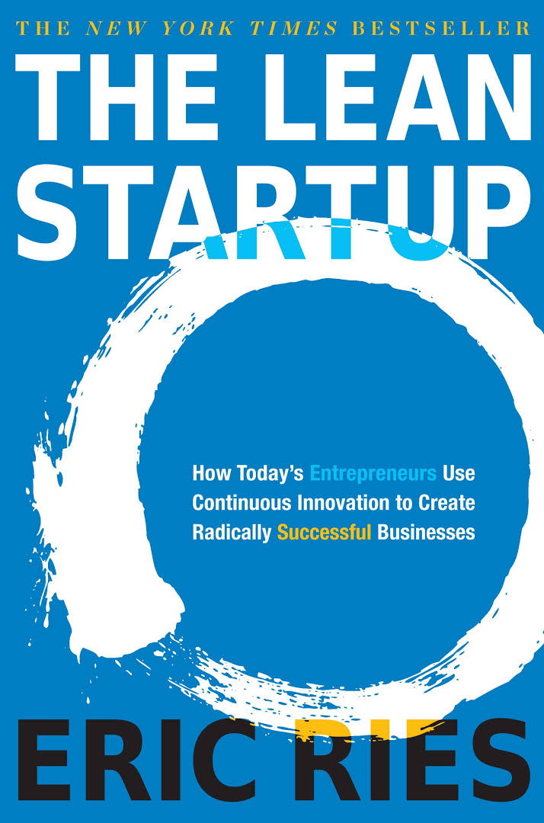
The lean startup

Slide 14
"The Lean Startup" by Eric Ries - BOOK SUMMARY
https://youtu.be/sobxOzRjAGg

Slide 15
Leap of faith assumptions
“An Entrepreneur’s Super Power”
What assumptions?
Value Hypothesis
Growth Hypothesis

Slide 16
Build – measure – learn
Kaizen - Continuous and incremental improvement
Small Batch Approach
Steer the Ship
Notes:
Henry Ford vs. Toyota Production System
Injection Molding vs. 3d Printing

Slide 17
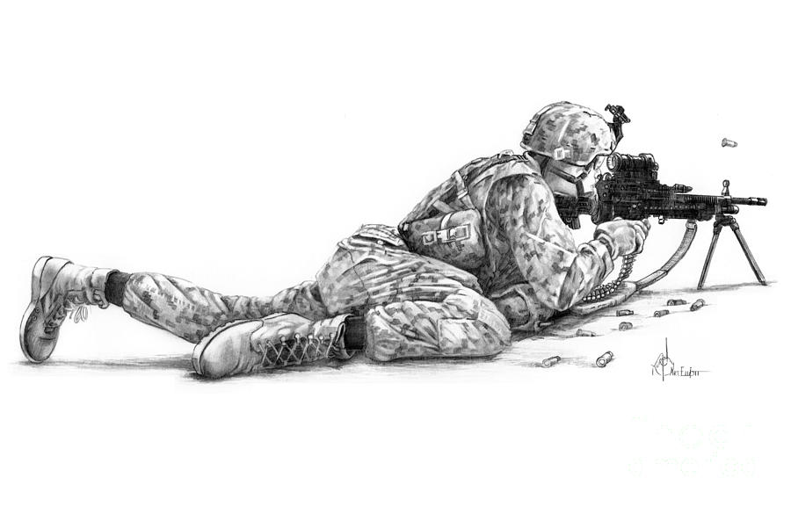
Build – measure – learn
Notes:
Sniper:
Wait for target
Take into account: distance, wind, temp/humidity
Get one shot
Analogous to old school business plan approach to startups
Roadmap
Waze analogy
Tell me where you’re going and I’ll help you get there
Updates based on traffic, road conditions, etc
Crowdsourced knowledge

Slide 18
Minimum Viable product - MVP
Types of MVP
Video MVP (looks like)
Concierge MVP (works like)
START!!!

Slide 19
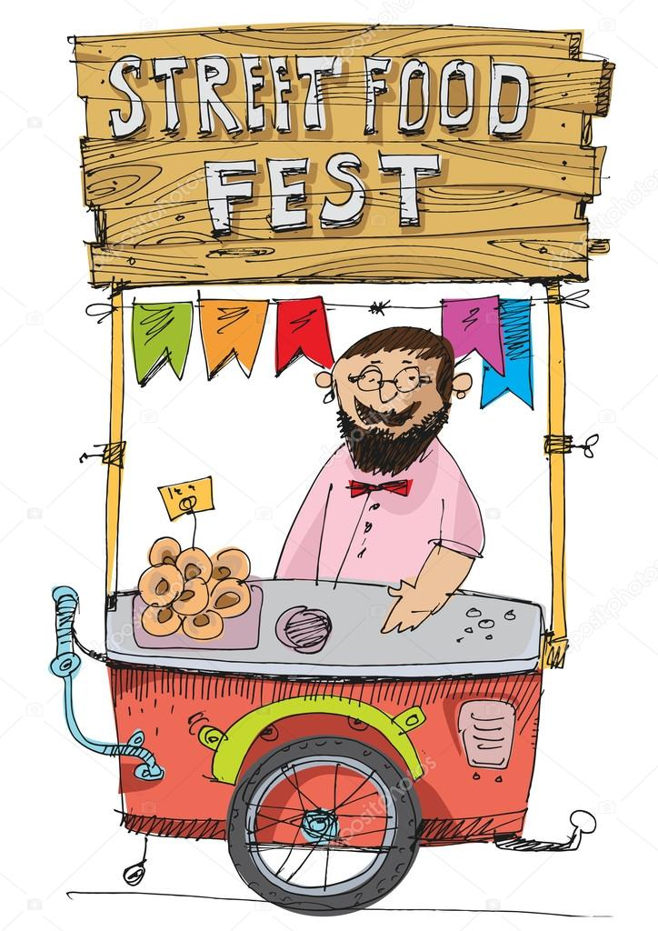
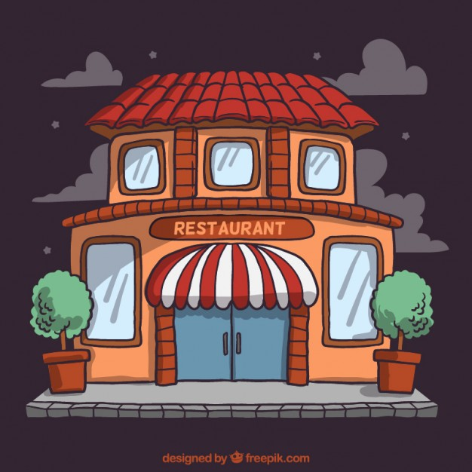
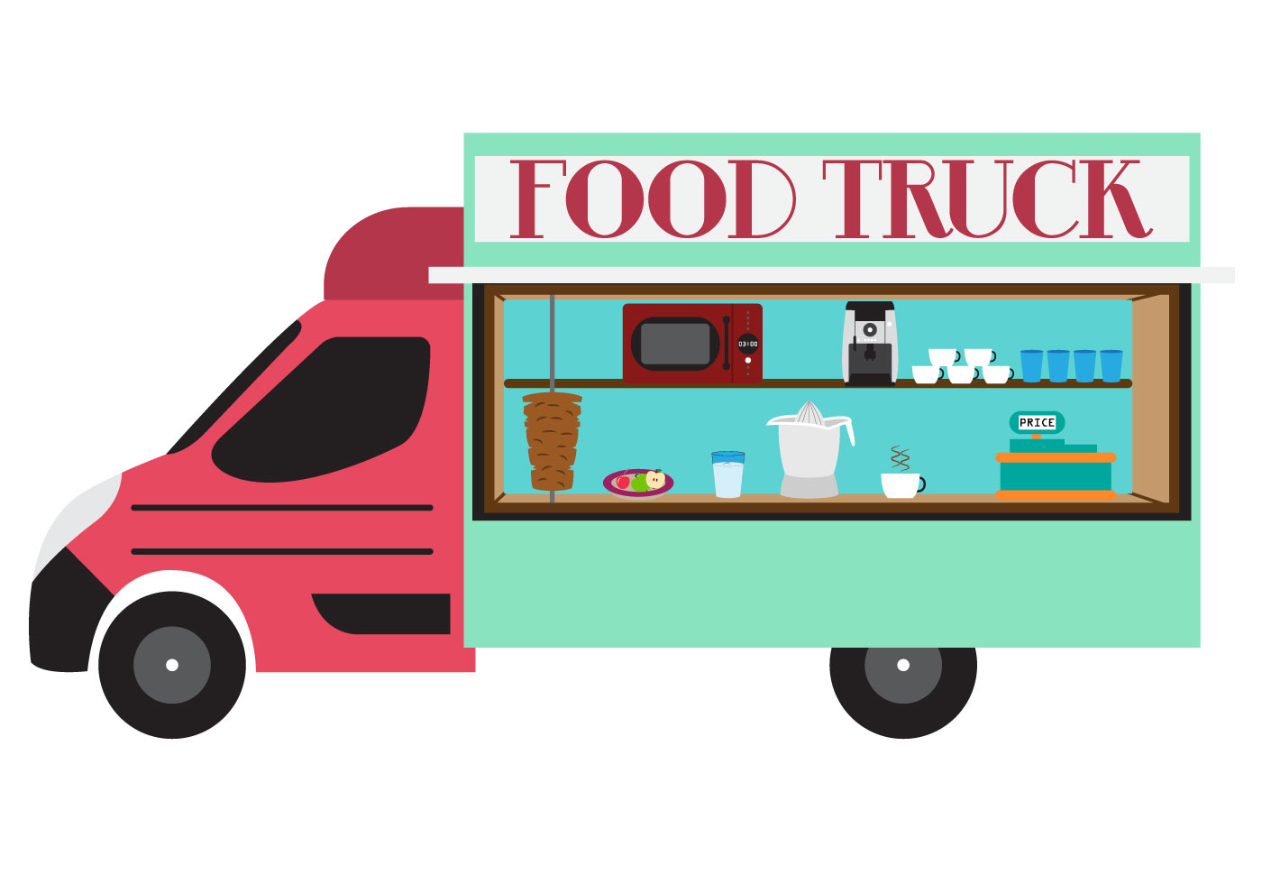
MVP Restaurant Example
MVP²
MVP
End Goal
Notes:
9/6/18:
Cost to build a restaurant was $735,326 or $5,452 per seat
https://www.restaurantowner.com/public/How-Much-Does-it-Cost-to-Open-a-Restaurant.cfm
Estimated cost to start a food truck is $50,000 (low end)

Slide 20
Think lean Challenge
Can we answer the question Cheaper?
Can we answer the question Faster?
Can we take it to the customer Sooner?
Do we really need to do this / build this?
How does this mitigate risk?
There is nothing so useless as doing efficiently
that which should not be done at all. – Peter Drucker

Slide 21
Why entrepreneurship?

Slide 22
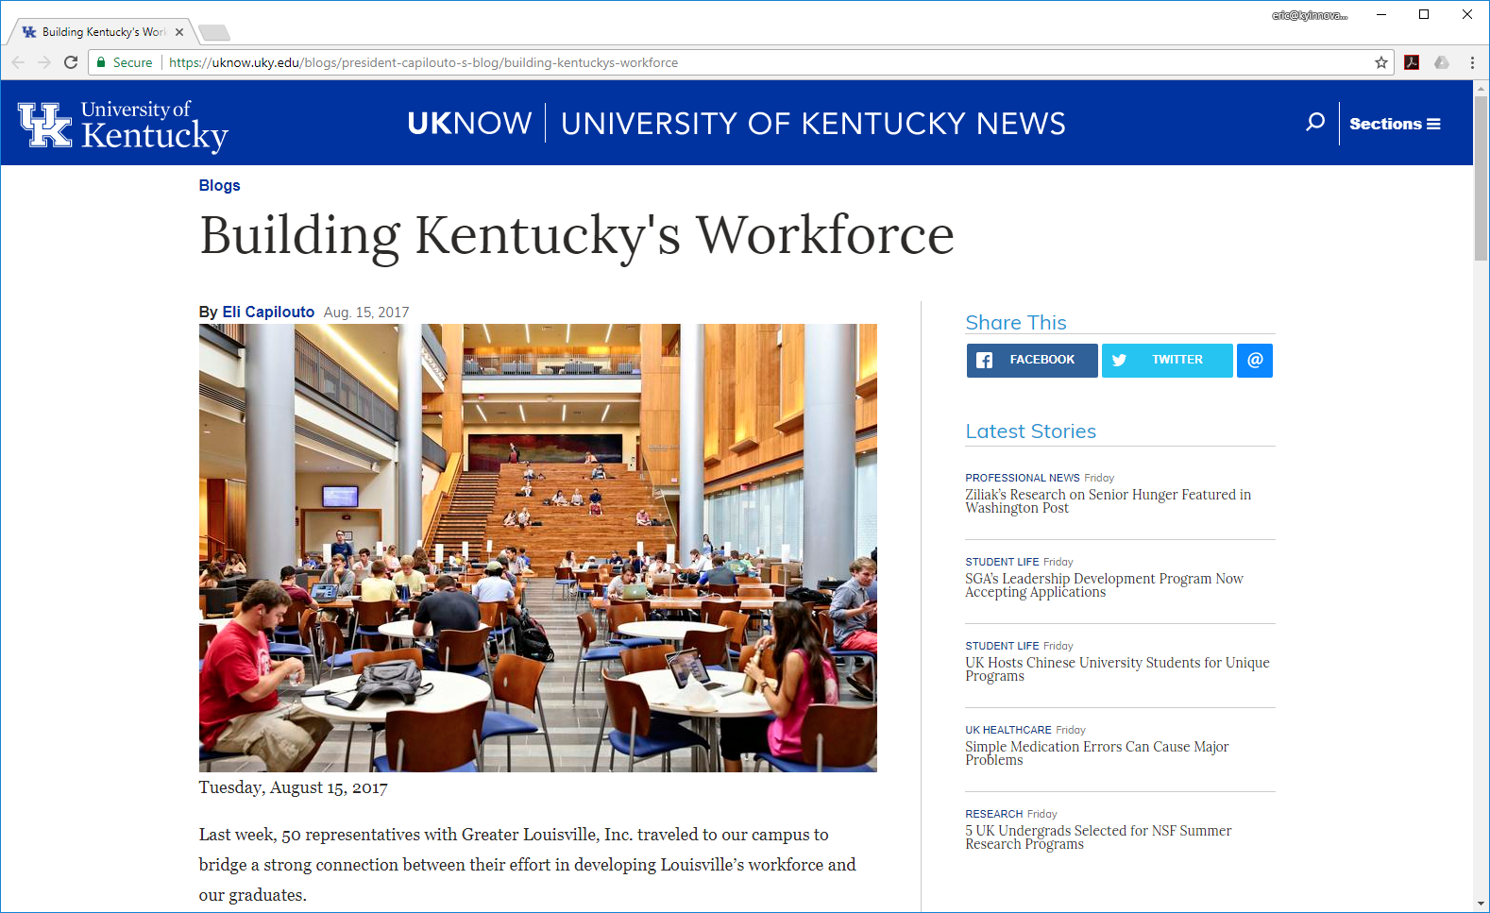
New York Times columnist Thomas Friedman writes:
“Graduates today will have to ‘invent’ a job … and, given the pace of change today, even reinvent, re-engineer, and reimagine that job.”

Slide 23
Eric Hartman
eric.hartman@uky.edu
HartmanKY
@HartmanEricC

