Slide 1
I Have an IDEA?
© 2018 Christine Wildes

Slide 2
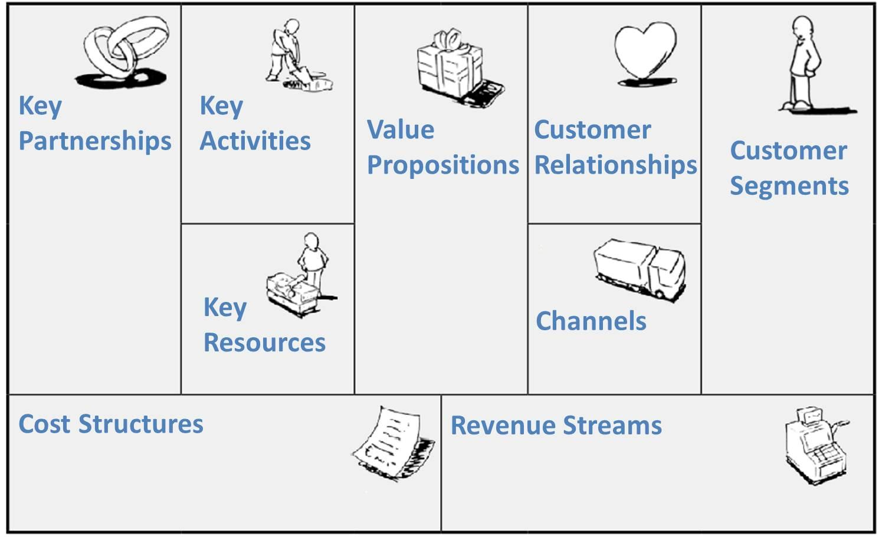
The business model canvas

Slide 3
The canvas - A Blank Space
What?

Slide 4

The canvas -
What?

Slide 5

What?

Slide 6
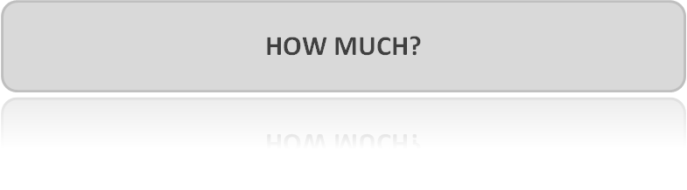
The canvas -
What?

Slide 7
The business model canvas

Slide 8


Slide 9
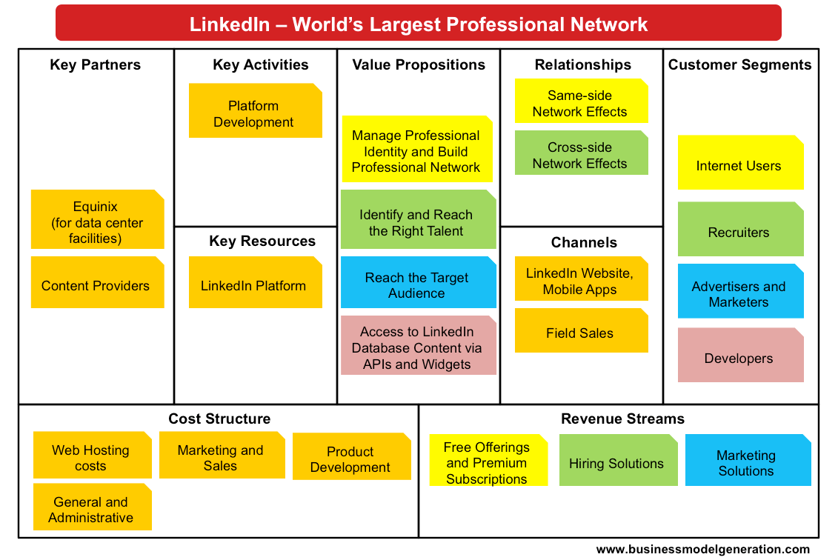

Slide 10
What’s your offer?
Which “jobs to be done” do you satisfy?

Slide 11
The Value Proposition
Value Created Through…
Newness | Price
Performance | Cost Reduction
Customization | Risk Reduction
Getting the job done | Accessibility
Design | Convenience
Brand/Status | Usability

Slide 12
Who’s your customer?
Which customer segments do you serve?

Slide 13
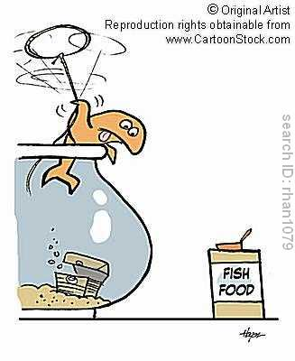
Do you know your customer?
The Problem
Solution?
•Do you know what their problem is?
•How important is it to the customer ?
Who is(are) the target customer(s)?
  Mass market Vs niche
  Single segment Vs multi-segments

Slide 14
How do you reach your customers? How is the product promoted?
Notes:
Coke – Retail – Vending Machines Restaurants

Slide 15
Channel Talk
Coca-Cola – Sells their product to consumers and like other businesses, they have many ways they can get to you.
  Retail – Grocery Stores, Convenience Stores, etc.
  Vending Machines – often owned by property managers who is providing a service to visitors.
  Restaurants – You’ll seldom find Coke & Pepsi offered at the same location.
Direct:
  Sales Force
  Online
  Own stores
Indirect:
  Partner stores (physical/online)
  Wholesalers (physical/online)
Key question: who takes care of after-sales service?

Slide 16
What’s your relationship to the customer?
How do you get, keep, and grow customers?

Slide 17
Get Keep Grow
Getting Customer
  The act of getting customers is about promotional activities that are both paid and "free."
Keeping Customers
  The old adage is that the best customers are ones you already have. This applies to keeping and growing the customer base and should be the advice given to your clients.
  Keeping customers is all about valuing the customers a business has. Loyalty programs and customer service are ways businesses can keep customers. Ultimately it's how a business can make a customer feel valued.
Growing Customers
  Existing customers are less expensive to sell to than new customers. You should think about ways to provide new or expanded goods/services to your customers.

Slide 18
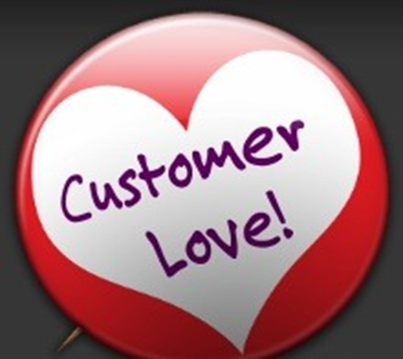
Customer Relations -
Where there is love there is growth?
•Viral- Customers love you so they get at least one other person to use/ buy i.e. Facebook,
•Customer Acquisition- You pay to market your product and the profit from the customers you gain is greater than the marketing costs??? (N.B. Margins often need to be high)
•Stickiness- Customers “love” you so they keeping coming back for more e.g. Apple- McDonalds.

Slide 19
What must take place to realize the VP for customers
& success of the channels & produce income from the $ streams

Slide 20
ACTIVITY
Based on our value propositions, what kinds of activities are key to our business?
What kinds of activities are key to our distribution channels?
What kinds of activities are important if we want to maintain our customer relationships?
What kinds of activities are fundamental to our revenue streams?
Research & Development
Production
Marketing
Sales & Customer Service

Slide 21
Physical Intellectual Human
Financial

Slide 22
The Key Resources
Which resources should I use to make my business successful?
It’s about choosing and then planning the proper set of resources,
* Physical (machineries, raw material)
* Intellectual (patents, brand)
* Human (developers, managers)
* Financial

Slide 23
4 Types:
1.Strategic Alliances (Non-competitors)
2.Competition
3.Joint Venture to Develop Business &
4.Buyer – Supply relationships

Slide 24
The Key Partners
Who could I cooperate to create value with?
We can distinguish between for different types of partnerships:
* Strategic alliances
* Coopetition
* Joint Ventures
* Buyer-Supplier relationships

Slide 25
What is driving cost?

Slide 26

Price?
Amount of money a company charges for items it offers for sale.
JIF: Introduced in 1958, all JIF peanut butter (now owned by Smucker's) is made in Lexington.
Fun fact: The JIF plant uses 188 billion peanuts a year.

Slide 27
^{Considerations}
^{Cost}
^{Competition}
^{Perception}
^{Customers}
Which is the Better Buy?
Price/number of units = cost per unit
Price Per Unit:
20 ounces of Soda for $.95/20 ounces = $0.05 per ounce
12 ounces of soda for $.75/12 ounces = $.06 per ounce

Slide 28
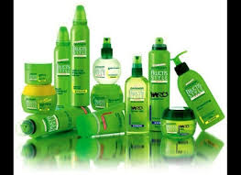
^{Considerations}
^{Cost}
^{Competition}
^{Perception}
^{Customers}
The beauty product manufacturer L’Oreal, makes Garnier Fructis
* Florence

Slide 29
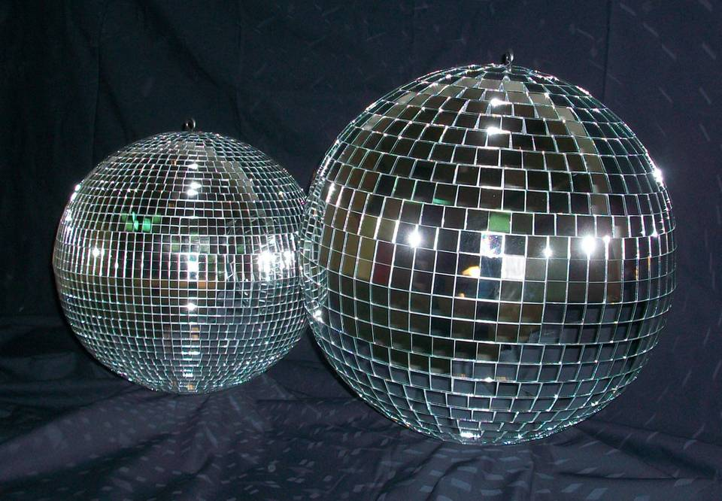
^{Considerations}
^{Cost}
^{Competition}
^{Perception}
^{Customers}
Ninety percent of all disco balls made in the U.S. are manufactured by Omega National Products in Louisville, which also makes kitchen cabinetry.

Slide 30
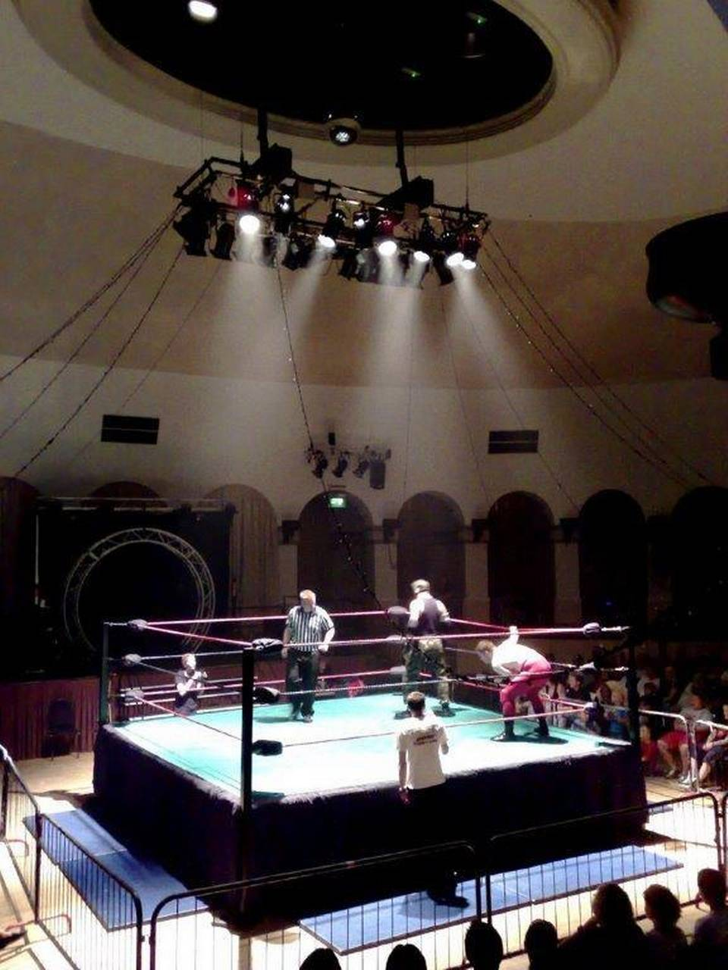
^{Considerations}
^{Cost}
^{Competition}
^{Perception}
^{Customers}
Monster Rings and Cages in Lawrenceburg designs and ships boxing rings, wrestling cages and other fighting equipment worldwide. Many famous rings, such as the one in Madison Square Garden, were made in Kentucky.

Slide 31
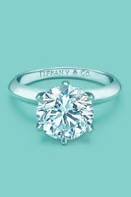
Cost
Expenses directly related with producing or making a product or service
To design a custom engagement ring:
Cost of CAD design
Cost of Material
  Stones
  Metals
Cost of Labor
Appraisal Cost
Tiffany & Co., in Lexington, produces the classic six-pronged engagement ring and other pieces of fine jewelry.

Slide 32
Costs – Two Types
Fixed Costs – Costs that don’t change over time. Foundation of business to run month-to-month
Rent
Salary/wages
Utilities
Variable Costs – Costs that fluctuate based on business activity.
Business sells 5 units in month 1 = 5*X
Business sells 500 units in month 2 = 500*X

Slide 33
How do you make money?

Slide 34
Revenue Streams – How your company will make money.
Asset Sale - (the most common type) Selling ownership rights to a physical good. e.g. Wal-Mart
Usage Fee - Money generated from the use of a particular service e.g. UPS
Subscription Fees - Revenue generated by selling a continuous service. e.g. Netflix
Lending/Leasing/Renting - Giving exclusive right to an asset for a particular period of time. e.g. Leasing a Car
Licensing - Revenue generated from charging for the use of a protected intellectual property.
Brokerage Fees - Revenue generated from an intermediate service between 2 parties. e.g. Broker selling a house for commission
Advertising - Revenue generated from charging fees for product advertising.

Slide 35
Exercise
Describe your business in one
sentence
This is how it’s done: “my company,
_(insert name of company)___,
is developing _(a defined offering)___
to help _(a defined audience)______
(solve a problem)____
with _(secret sauce)_________”.

Slide 36
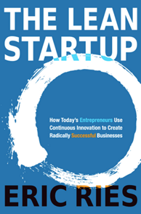
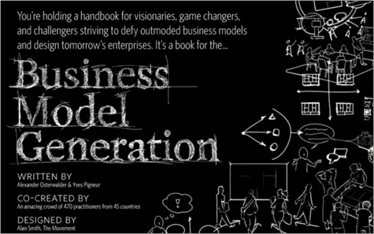
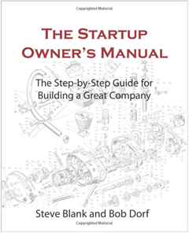
Acknowledgements

